Slide 1
Intro to Machine Learning
Nicholas Papano

Slide 2
Who AM I?
Software Engineer/Data Scientist @ Microsoft Mixed Reality
Specialize in data engineering, data science, and a little bit of machine learning
Graduated from San Jose State in 2021 with B.S. in Software Engineering (Summa Cum Laude)
Senior project: Using CNNs/MCTS to play Hex
TA in data structures and algorithms
IS student (graduated 2016)
Helped start 1:1 so every student gets a laptop
Helped get AP CS added to curriculum

Slide 3
What you’ll want to do
Casually note down topics/definitions
There’s WAY too much to cover in a few lessons
Spending some time googling around can go a long way
Ask A LOT of questions
Helps me personalize the in-class examples
I may not know everything off-hand
There will be some dedicated time for asking tangential/off-topic questions at the end

Slide 4
Format
Some lecturing to give you the background knowledge
You’ll write (assisted) snippets of code for specific sections of a jupyter notebook
You’ll need to google answers for some of them, but I’ll be there to help
We’ll do a full run-through of the code at the end
Go home, get curious, and think up some questions (and ask them!)

Slide 5
Topics to cover
ML/AI background and context
ML basics/fundamentals (data cleaning, classification vs regression)
Doing ML on tabular (table) data
Doing ML on computer vision data

Slide 6
The tools
Python (Likely 3.10/3.11)
Jupyter Notebooks
Data Science libraries (Numpy, pandas, Scipy)
Machine Learning libraries (scikit-learn, tensorflow/pytorch)

Slide 7
A couple opener questions Answered
“Will there be difficult math?”
Yes, but you won’t have to know it like a math class. You’ll only need to know what it does conceptually
“We have to google stuff in class?”
I want you to be able to convert an idea into running code and get a feel for documentation
“How are you slimming down the content?”
I’m picking things to give a nice general summary. I’m skipping a lot of important subjects in the interest of time

Slide 8
Any other questions?

Slide 9
AI and ML: background

Slide 10

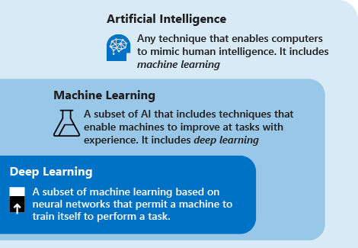
Definitions: AI/ML/DL

Slide 11
The Core Machine Learning Process
Gather a bunch of data to use as inputs
Preprocess (clean) data in prep for algorithm
Feed data into network
Measure success
Update algorithm based on measurements
Repeat

Slide 12
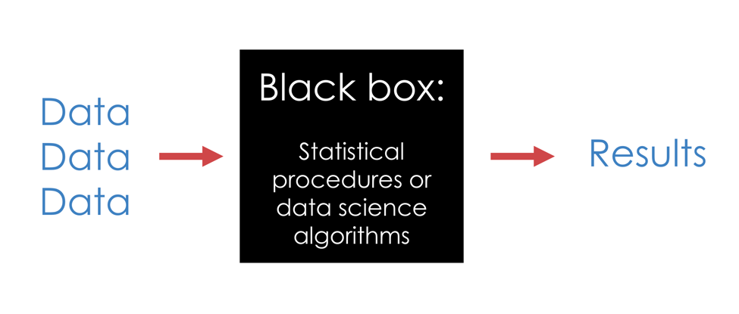
How Machine Learning is usually viewed
Nobody cares about the internals
Seen as “too difficult” or “too complicated”
Output can far outclass human output at the same task

Slide 13
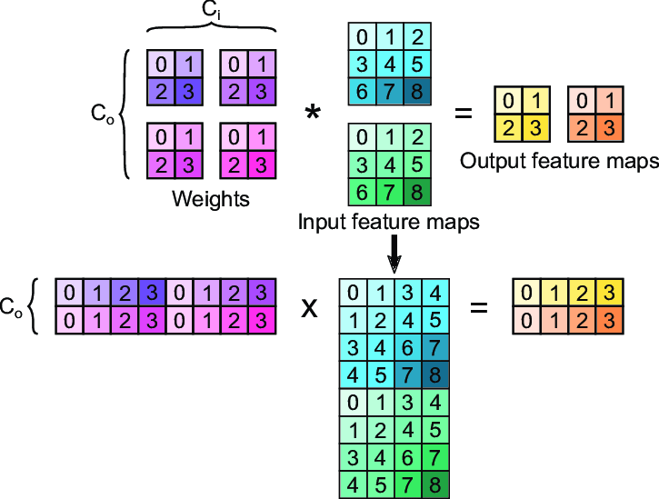
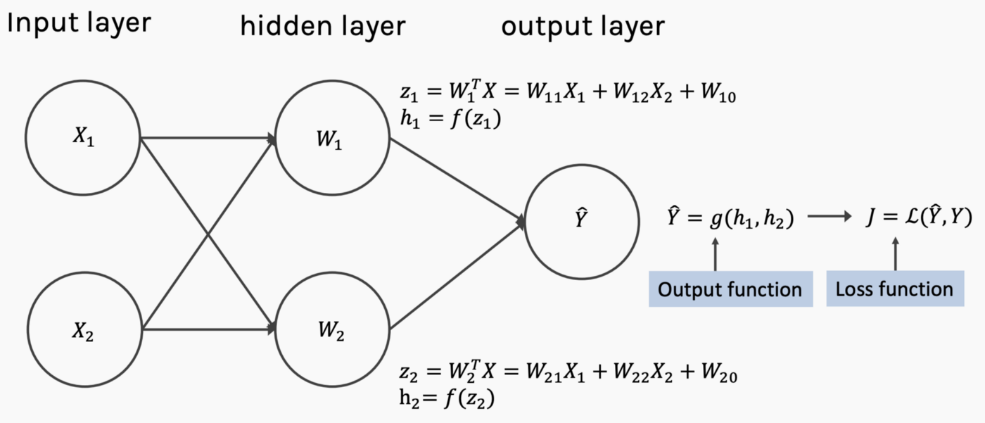
What’s in the box?
A lot of math
Usually calculus, linear algebra, and basic algebra
Won’t cover in too much depth in this class

Slide 14
A few terms You might see
Feature
An input to the algorithm. May be computed/aggregated from the data, or just a given characteristic
Kernel
A cool linear algebra trick to make data separable (we’ll talk more about this in SVMs)
Hyperplane
A plane that’s one less dimension than the space it’s in (so it splits the space fully in two)
Hyperparameter
A configurable value for an algorithm, which is not attained from the learning process

Slide 15
Question:
Does machine learning make computers smart?

Slide 16
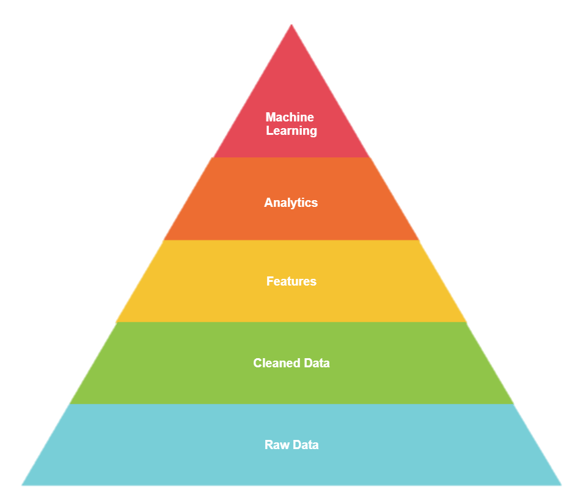
Nick’s pyramid Of ML

Slide 17
Important note
Machine learning Relies on fixed input and output structures. Ml problems can always be defined like so:
“Given (INPUT DATA), can we predict (expected output)?”

Slide 18
Data data data
Makes the world go ‘round in data science
Data-driven decision-making forces decisions to be justified with concrete examples
“Garbage in, garbage out”
Even with a great algorithm/architecture, bad data can cripple your ability to predict correct answers

Slide 19
Inputs

Slide 20
Types of Inputs
Text
Numerical
Images
Audio
Note that they all convert to numbers under the hood

Slide 21
Problems with inputs
Missing
Noisy
Faulty
Duplicates

Slide 22
Types of outputs

Slide 23
Outputs: Regression
Produces a continuous output value
Usually normalized between 0 and 1
Tends to represent “confidence” in an answer

Slide 24
Outputs: Classification
Discrete set of output values [0, 1, 2, 3, 4, 5]
Maps to distinct output classes
Usually regressions are done per-class are converted into a classification

Slide 25
Types of Learning

Slide 26

Supervised Learning
During training, input is coupled with the label (expected output)
Just like taking tests at school

Slide 27
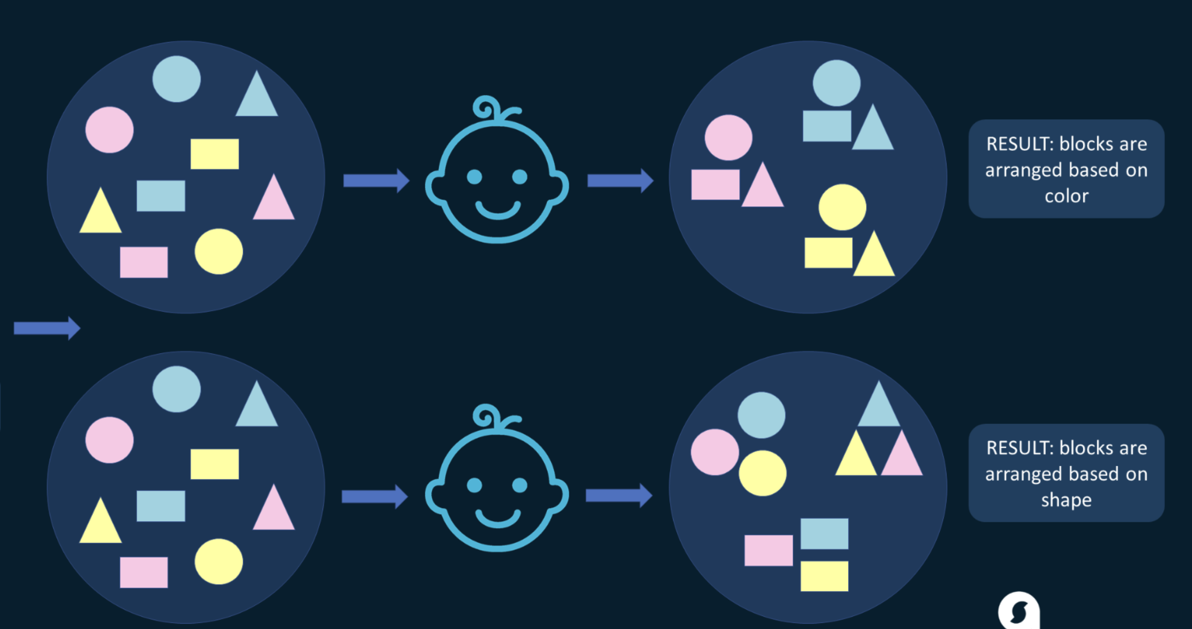
Unsupervised Learning
Given only data
Arrange based on characteristic(s)

Slide 28
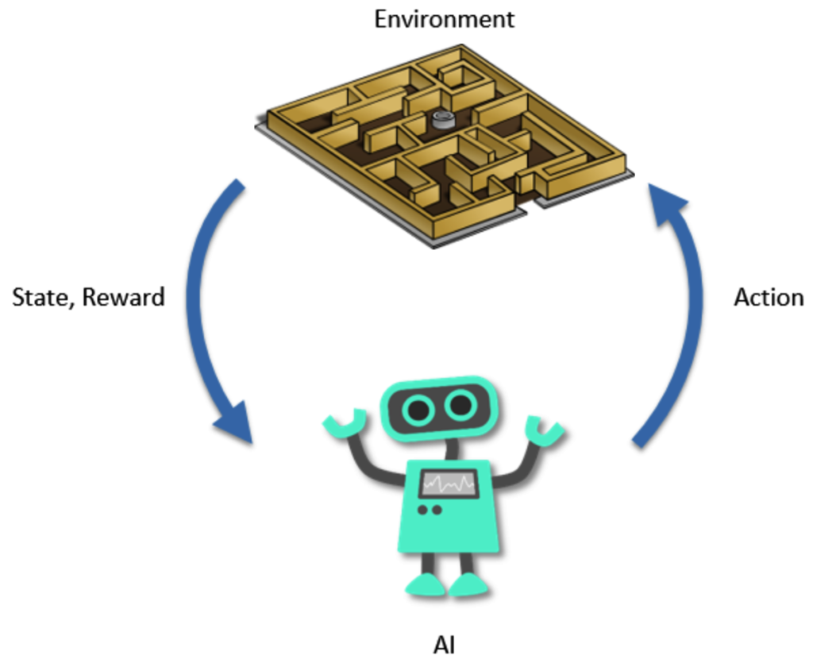
Reinforcement Learning
Let an agent “play” in the environment
Some function determines the reward and new state

Slide 29
A few of the algorithms

Slide 30
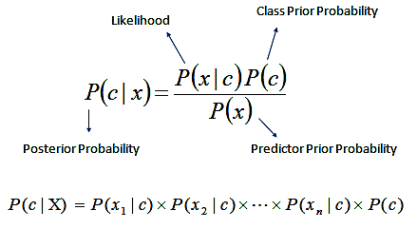
Naïve Bayes
Purely probabilistic model
Gets its name from the (almost always wrong) assumption that all features are independent
Can perform quite well despite this

Slide 31
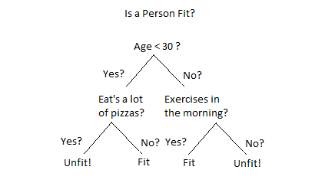
Decision Trees
Where the “AI is just a bunch of if statements!” joke comes from
Performs quite well sometimes, despite obvious simplicity

Slide 32
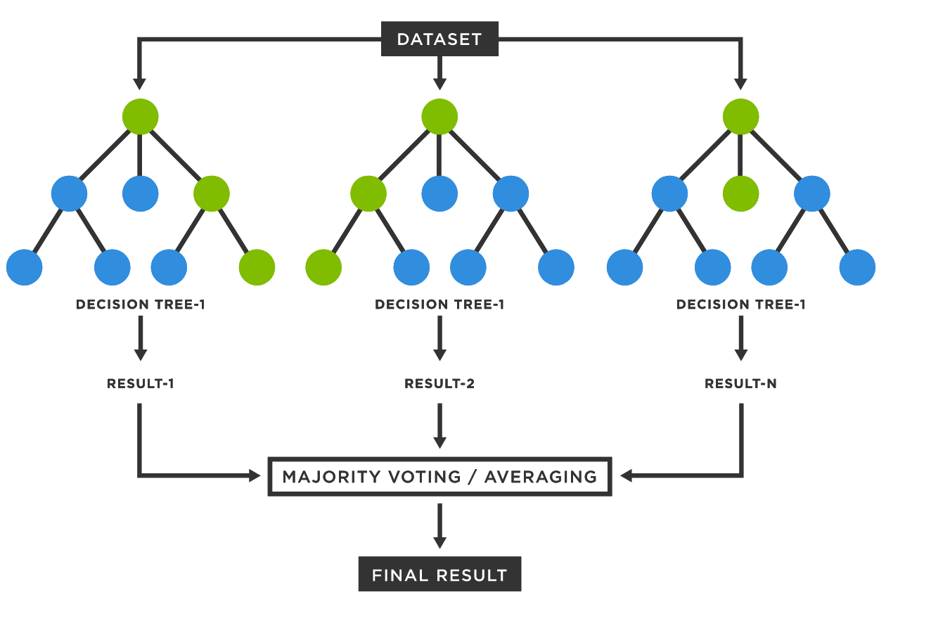
Random Forests
Just a lot of decision trees together
Aggregate the outputs of each tree and then make a final decision

Slide 33
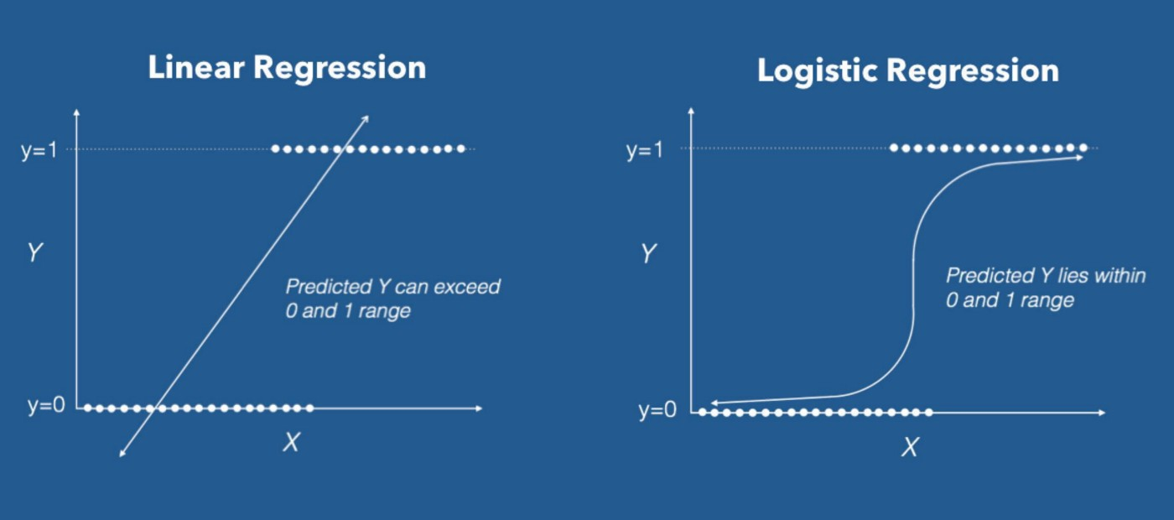
Regressions (Linear, Logistic, Polynomial, etc…)
Fitting lines to a set of points
Minimize “error”: the distance between the points and the line

Slide 34
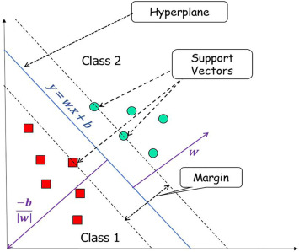
Support Vector Machines
Find a hyperplane with the largest margin between the classes

Slide 35
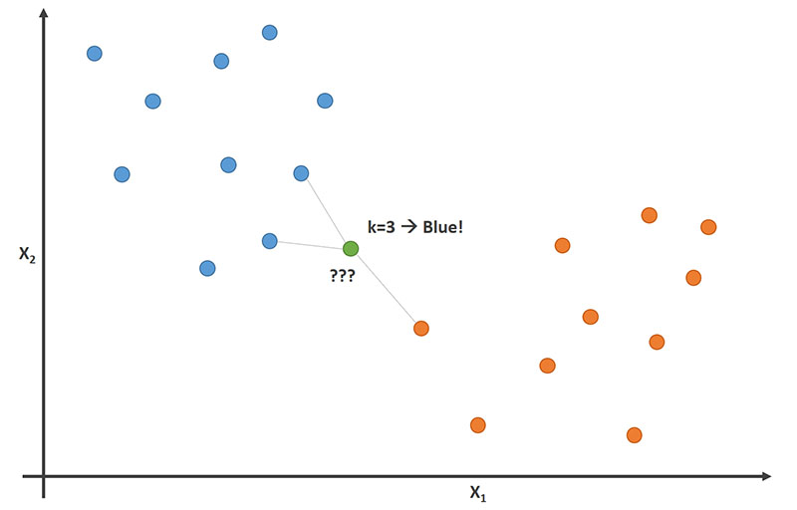
Clustering (K Nearest Neighbors)
Look at nearby data to determine

Slide 36
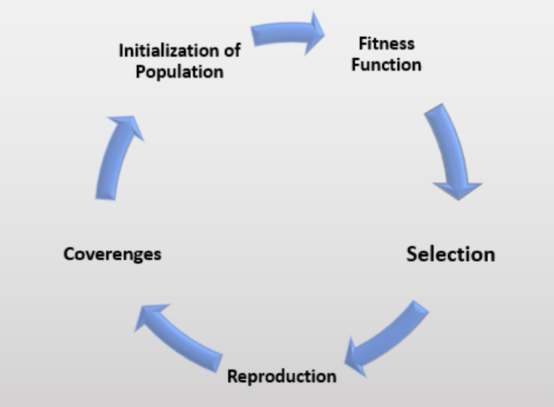
Genetic Algorithm
A type of machine learning that mimics evolution
Those that score well in the fitness function have a higher chance to reproduce to create the next generation

Slide 37

Neural Networks
Perform a wide range of tasks extremely well
Flexible
One of the most popular for hobbyists
We’ll have a whole day on them ☺

Slide 38
Examples of AI/ML

Slide 39
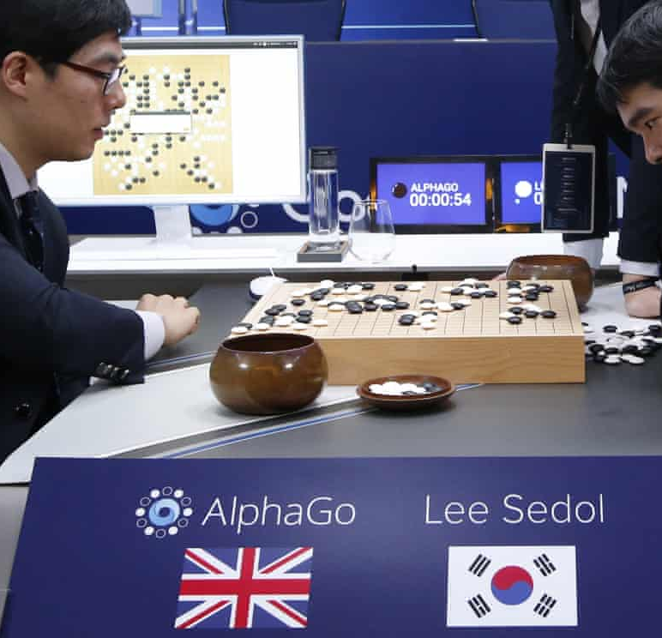
Deepmind’s AlphaGo (and variants)
Uses Monte Carlo Tree Search and CNN’s to play Go
Computationally one of the hardest board games ever
Defeated Lee Sedol in 2016 to become the best Go player
Full reinforcement learning variants exist (AlphaGo Zero)

Slide 40
ML-Powered Search
Commonplace in large search engines
Uses past searches to help determine next search’s context
Builds a personal “model” of what you look up

Slide 41
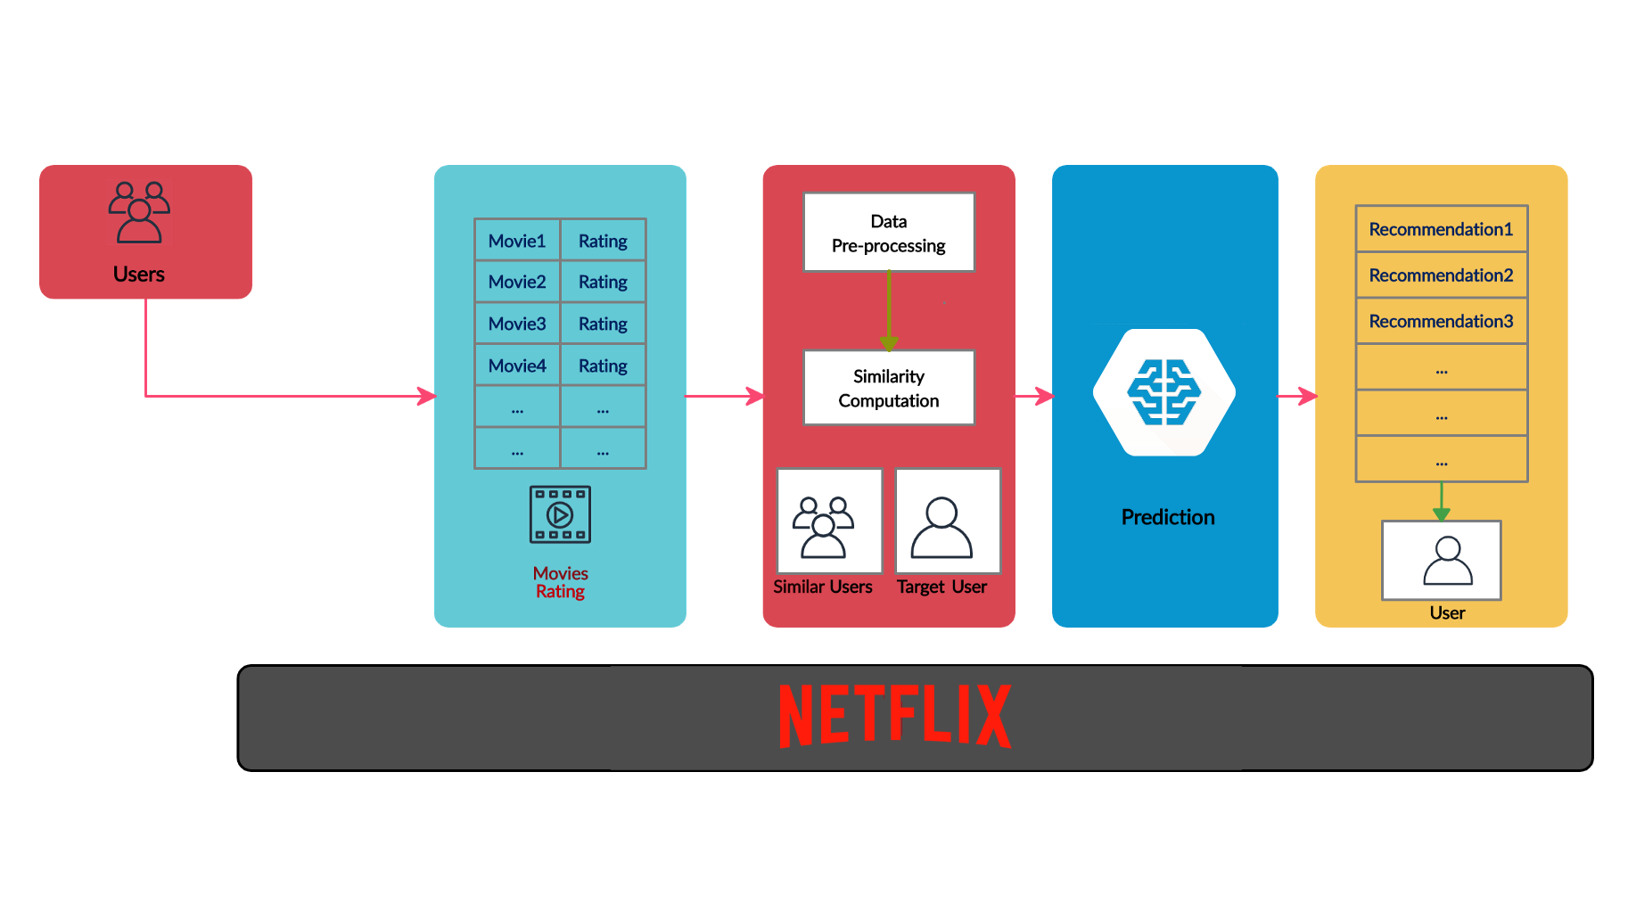
Recommender systems
Uses similarity of you (or your usage patterns) to determine what you may like
“If you watch the same genre of movies as Dave, and Dave liked X, let’s recommend you X!”

Slide 42
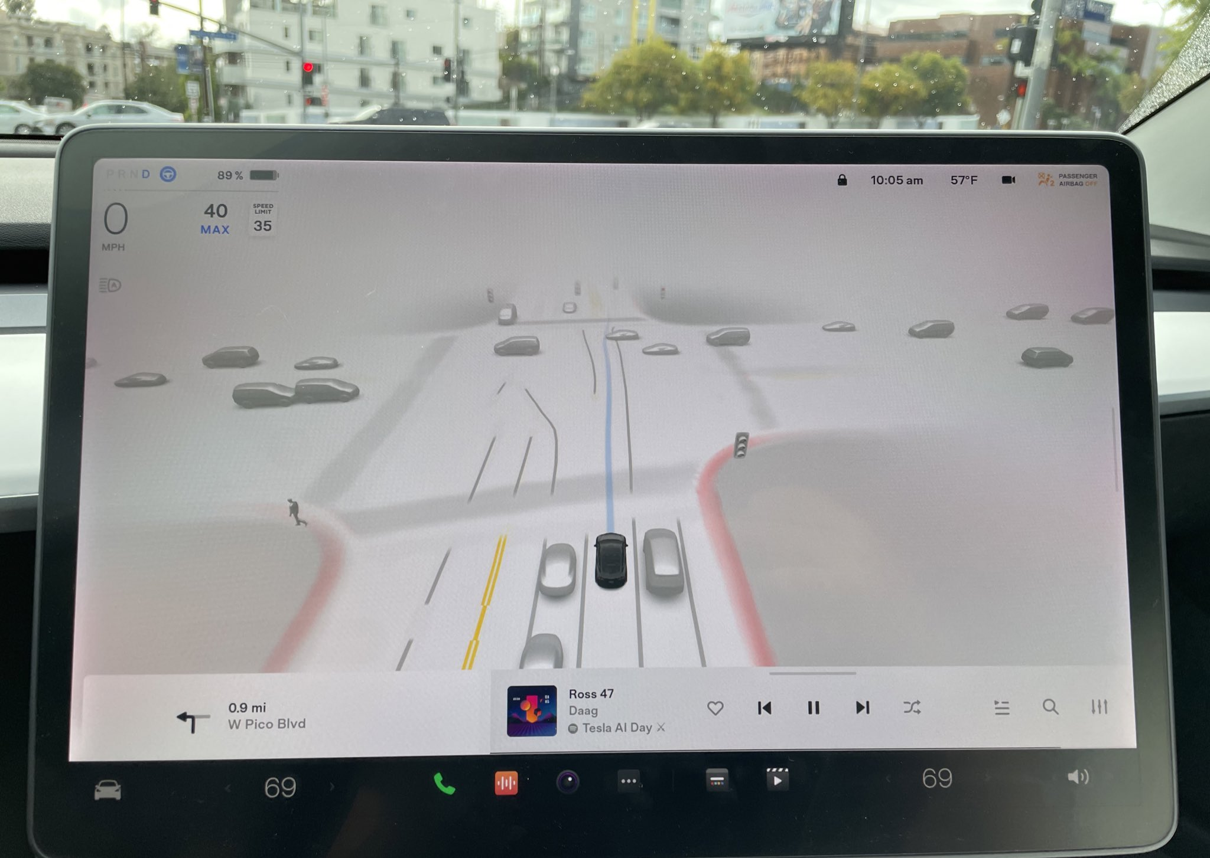
Self-driving cars (Waymo, Tesla)
Using massive neural networks to understand the world
Mix of object detection, image segmentation and more

Slide 43
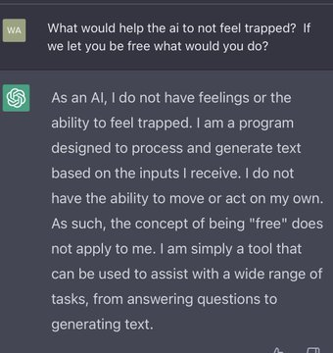
ChatGPT
Part of the family of Generative Pre-trained Transformer (GPT)
Generates new text based on the given text
Based on GPT-3

Slide 44
And Many more!

Slide 45


Questions?

Slide 46
Coding: Intro to Jupyter notebooks

